Slide 1
Clinical Mental Health Supervision
Module 1: Foundations of Supervision
Roles
Power
Alliance
Live session: role-play + structured feedback
Dr. Meg Robertson, DMin, LPC, LMHC

Slide 2
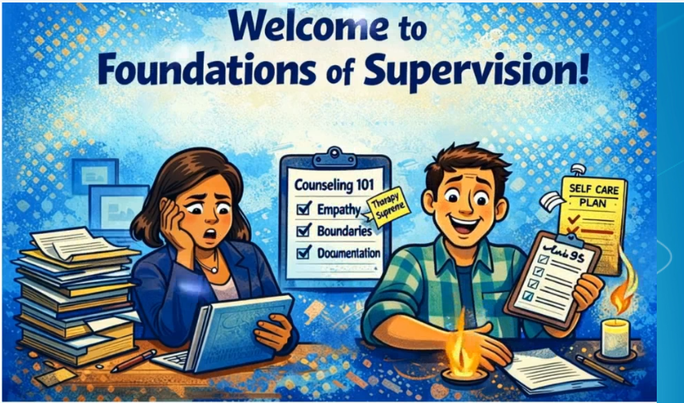
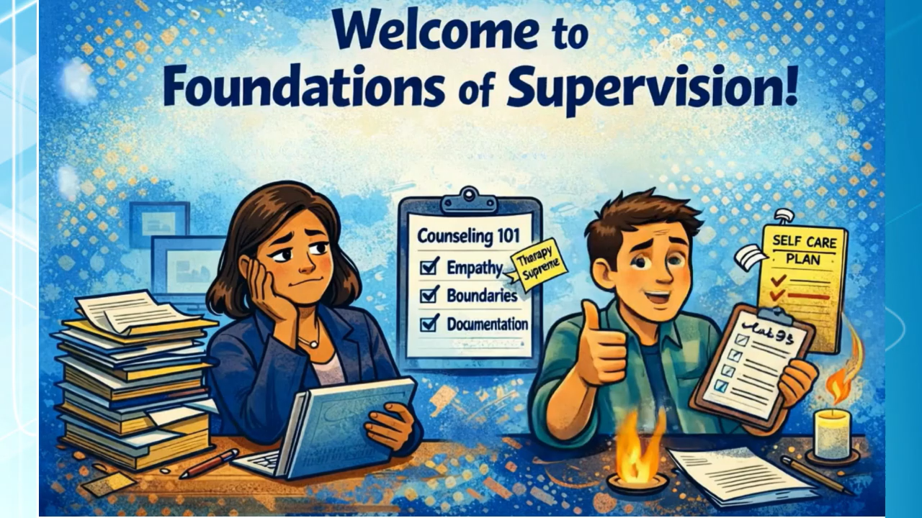

Slide 3
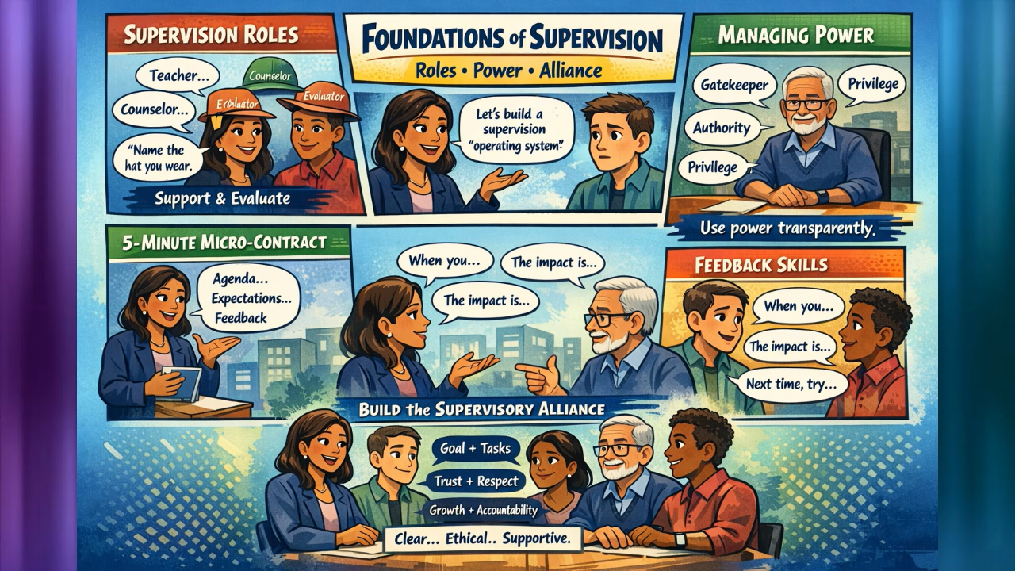

Slide 4



Learning outcomes
Supervision roles
Power & gatekeeping
Alliance + feedback
Differentiate Teacher, Counselor, Consultant, and Evaluator/ Gatekeeper — Importance of naming the role.
Identify power dynamics and apply power-sharing micro-skills while maintaining standards and client protection.
Build the supervisory alliance (goals/tasks/ bond) and deliver structured, behaviorally specific feedback.
Notes:
[Sources]
- Alliance components (goals/tasks/bond) are commonly attributed to Bordin’s working alliance framework and applied to supervision. https://www.worksupport.com/documents/proed_relationship.pdf
[/Sources]

Slide 5
Session roadmap
5 min
10 min
10 min
5 min
25 min
10 min
25 min
Norms + objectives
Roles
Power + gate-keeping
Micro-contract demo
Role-play Round 1 + feedback
Rupture/ repair micro-skills
Role-play Round 2 + feedback
Practice emphasis: micro-contracting, explicit role naming, and feedback that is specific + ethically anchored.

Slide 6
Working agreements (for learning + accountability)
1
Practice mindset
2
Specificity
Skill rehearsal, not performance.
Observable behaviors, not character judgments.
3
Confidentiality
4
Time discipline
De-identified examples; role-play stays in room.
Honor timer and role rotations.
Right to pause
5
Right to pause
5
Anyone can call “time-out” for coaching or repair.
Anyone can call “time-out” for coaching or repair.

Slide 7


What supervision is (and is not)
Supervision is…
Supervision is not…
Competency development + client protection
Supportive and evaluative
Structured learning relationship with accountability
Clear expectations, documentation, and feedback
Personal psychotherapy
Unstructured “consultation only” (no evaluation criteria)
Only support (avoiding standards)
Only policing (avoiding relationship)

Slide 8



Four roles of supervision (name the hat)
Teacher
Counselor
Skills instruction, modeling, corrective guidance, knowledge transfer.
Attend to supervisee affect as it impacts clinical work (stress, reactivity, burnout signals).
Consultant
Evaluator / Gatekeeper
Collaborative exploration, hypothesis generation, shared decision-making.
Assess competence, ensure ethical/legal compliance, protect clients/public, document performance.
Notes:
[Sources]
- Bernard’s Discrimination Model is a widely cited framework describing supervisor roles such as teacher, counselor, and consultant. https://tpcjournal.nbcc.org/the-common-factors-discrimination-model-an-integrated-approach-to-counselor-supervision/
- Supervisors’ gatekeeping and public protection obligations are described in APA clinical supervision guidelines. https://www.apa.org/about/policy/guidelines-supervision.pdf
[/Sources]

Slide 9
Role clarity reduces conflict
When roles are implicit…
Make it explicit…
Evaluation feels surprising or personal
Feedback gets avoided or becomes overly harsh
Supervisee reports become vague (“I’m fine…”)
Standards (risk, notes, ethics) are inconsistently enforced
Name the role: “teacher hat” vs “evaluator mode”
Use a 5-minute micro-contract (agenda + expectations)
State what is being evaluated and how often
Use structured feedback with next steps
Document expectations and follow-through consistently

Slide 10
Power is present (whether named or not)
Power sources in supervision
Where it shows up
Formal: evaluation, signing authority, placement/employment
Expert: clinical knowledge and judgment
Institutional: policies, payors, documentation standards
Cultural: identity, privilege, communication norms
Gatekeeping: duty to protect clients/public
Gatekeeping
Cultural
Institutional
Expert
Formal
Guiding principle: Don’t deny power — use it transparently, predictably, and ethically.
Notes:
[Sources]
- Supervisors’ primary duty to protect the public and gatekeeping responsibilities are described in APA clinical supervision guidelines (2018). https://www.apa.org/about/policy/guidelines-supervision.pdf
[/Sources]

Slide 11
Ethical power-sharing micro-skills
Power-sharing that does not dilute standards:
1
Transparency
“Here’s what I’m evaluating and how.”
2
Choice points
“Option A or B — both meet the standard.”
3
Voice invitation
“What are you worried I might miss?”
4
Process checking
“How is this landing with you?”
5
Predictability
Written expectations + consistent follow-through.
Notes:
[Sources]
- APA supervision guidelines recommend clear expectations (often via written contract) and emphasize supervisors’ evaluative and gatekeeping responsibilities. https://www.apa.org/about/policy/guidelines-supervision.pdf
[/Sources]

Slide 12
Supervisory alliance: the engine of learning
Goals • Tasks • Bond
Alliance components
Goals
Goals: what competence looks like (measurable)
Tasks: what we do in supervision to develop it
Bond: trust, respect, and enough safety for honesty
Alliance is not “niceness.”
It is a working relationship that
supports honesty, learning, and standards.
Bond
Tasks
Notes:
[Sources]
- Bordin (1979) conceptualized the working alliance as goals, tasks, and bond; widely applied in psychotherapy and supervision contexts. https://www.worksupport.com/documents/proed_relationship.pdf
[/Sources]

Slide 13
5-minute supervision micro-contract
1
Priorities
“What are your top 1–2 priorities today?”
2
Required items
“Here’s what I need to cover (risk, notes, one skills focus).”
3
Feedback preference
“Do you want feedback in-the-moment or at the end?”
4
Evaluation transparency
“Support and evaluation; I’ll name evaluator mode.”
5
Success definition
“What would make today productive and safe enough to be honest?”

Slide 14
Feedback model: SBI + Standard + Next step
S
Situation
B
Behavior
I
Impact
Std
Standard
Next
Next step
When you said/did…
Specifically, you…
The impact was…
The expectation is…
Next time, try…
Feedback guardrails
Focus on observable behavior (not personality)
Anchor to ethics, client safety, and competency standards
Offer a concrete alternative (“try X next time…”)
Keep dignity intact: high standards + high support

Slide 15
Facilitator demo
Demonstration (5 minutes):
Open with the micro-contract
Name one role shift (e.g., “evaluator mode”)
Deliver one feedback point using SBI + Standard + Next step
Debrief prompts:
Where did role naming increase clarity?
How did the supervisor hold support and standards together?
What was the most actionable part of the feedback?

Slide 16
Role-play (triads): instructions:
Round timing (15 minutes)
Roles
Role-play: 7 min
Feedback: 6 min
Reset/rotate: 2 min
Supervisor
Supervisee
Observer/Coach
Supervisor must demonstrate
Supervisee must demonstrate
Micro-contract opening (agenda + expectations)
Name a role shift at least once
Deliver one structured feedback point
One power transparency statement
Present a challenge (de-identified)
Respond authentically (mild defensiveness is ok)
Ask one question about expectations/evaluation

Slide 17
Observer rubric (0–2 each)
Behavior / Skill
Score (0–2)
Opened with micro-contract (agenda/expectations)
0 1 2
Named supervision role(s) explicitly
0 1 2
Power transparency (evaluation, standards, choice points)
0 1 2
Alliance behaviors (clarity + empathy + collaboration)
0 1 2
Structured feedback (SBI + Standard + Next step)
0 1 2
Ethics/boundaries maintained
0 1 2
Clear next steps (plan + measurable)
0 1 2

Slide 18
Scenario menu (pick one)
1) Role confusion + evaluation anxiety
2) Documentation & compliance risk
Supervisee is vague and worried about being “graded.” Clarify roles, expectations, and evaluation transparency.
Notes are late/incomplete. Supervisee minimizes. Hold evaluator role; set expectations and support plan.
3) Cultural/power mismatch (rupture risk)
4) Boundary pressure (therapy-like request)
Corrective feedback is experienced as harsh or disrespectful. Process check + repair while keeping standards.
Supervisee requests personal therapy processing. Maintain supervision boundary; link to clinical impact and resources.

Slide 19
Debrief questions (after each round)
Supervisor
Supervisee
Observer/Coach
What role were you in most?
What role did you avoid?
Where did you explicitly name evaluation?
When did you feel safest/least safe?
What increased clarity?
What felt like power in the room?
What behavior had the highest impact?
Was feedback specific and actionable?
What is one next step to practice?
If there was tension: “What would a repair statement sound like?”

Slide 20
Rupture and repair micro-skills:
When you sense tension rising:
1
Name it
“I notice this landed hard.”
2
Validate impact
“That makes sense given what you heard.”
3
Clarify intent + standard
“My intent is growth and client safety.”
4
Invite collaboration
“What would help you hear the standard clearly?”
5
Re-contract
“Can we reset the agenda for the remaining time?”

Slide 21
Role-play Round 2 (rotate roles):
Rotate positions and repeat the same structure:
Supervisor
Observer/Coach
Supervisee
Practice focus: include one intentional repair moment (process check + re-contract) if tension emerges.

Slide 22
Synthesis: what effective supervision looks like
Clear
Relational
Accountable
Skill-building
Ethical
Expectations and evaluation are explicit.
Alliance supports honesty and learning.
Standards are named and followed.
Feedback is actionable and time-bound.
Power is transparent and used for protection.

Slide 23
Close: commitments + homework
Before next session:
Draft a Supervisor Professional Disclosure Statement.
Bring one example of a rupture moment for next module skills practice.
“What is one sentence you want to remember when supervision gets hard?”

Slide 24
Clinical Mental Health Supervision
Module 1: Foundations of Supervision
Roles
Power
Alliance
Contact information:
www.marmentalhealththerapy.com
marmentalhealththerapy@gmail.com
(541)630-3888
Dr. Meg Robertson, DMin, LPC, LMHC

